Slide 1
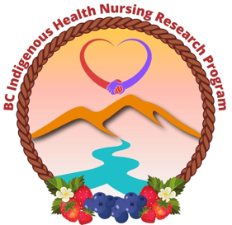
Co-Creating Parallel Pathways Indigenous Graduate Education in Nursing
CASN Conference
May 29, 2023
Leanne Kelly PhD (c)
Christina Chakanyuka PhD (c)
Dr. Joanna Fraser
Dr. Maureen Ryan
Dr. Leanne Currie
Dr. Lisa Bourque Bearskin

Slide 2
Unceded lək̓ʷəŋən & WSÁNEĆ Territories & Sencoten -speaking peoples where UVIC is situated. Recognizing and honoring the Songhees, Esquimalt and WSÁNEĆ peoples whose historical relationships with the land continue to this day.
Notes:
First let me begin by acknowledging our traditional territories where some of us may be situated.
Begin in gratitude, gratitude for to have another day, breathing in the fresh air, soaking up the energy we receive from each new day. Gratitude for the land from we are each located. To honor the ancestors that come with each of you, the four legged, the winged being, and the water people, grandmother moon, and grandfather sun, keeping an open mind to so we can advance our collective consciousness, as we listen to the land we hear the birds, we see the trees, and smell the water and we feel connected to our own spiritual ways of knowing that keep us grounded and centered, holistically rooted in wellness.

Slide 3
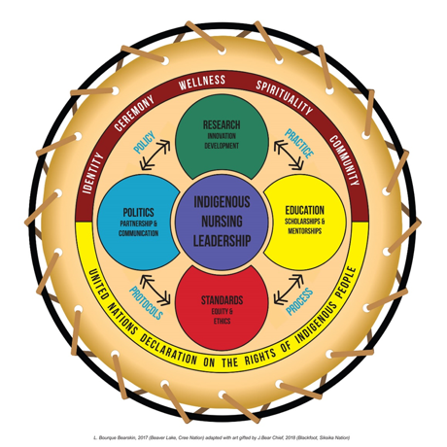
“generative” is āniskētastāwin meaning attachment through the ages where all people and realities like health are related and connected.
Advancing Indigenous Wellness by Reconciling Parallel Pathways in Indigenous Health Nursing: Innovating Wise Practices for Education, Standards, Partnerships, and Research
In memory of
Estella Patrick Moller
Nak’azdli Whut’en First Nation
In memory of
Lorette Seymour
Tk'emlúps te Secwépemc
Keteskwew Dr Madeleine Dion Stout 2022
Notes:
Model for IHN: Through this work with these stewards of Indigenous Nursing Knowledge, we recognize that practice, education, research, and politics are key components of IHN. Honoring our PEOPLES, Nurses, & Healers “The breath of life as a way to ground ourselves in our own spirit to nourish our minds and hearts so that we recognize our connection to one another and to the greater mystery of life and the land upon which we are all forever connected.”
These are defined as follows:
Education refers to programming and pedagogy within the academy and how Indigenous Knowledge is taken up and used as targeted strategy for IHN students through appropriate content, processes, scholarships and mentorships;
Standards refers to a Scope of Practice with key statements and indicators that promote equity amongst Indigenous and non- Indigenous nurses through relational and ethical space31, as per the Code of Ethics;
Politics refers to the context of nursing leadership roles. It signifies facilitating collaborative and authentic partnerships through effective communication with Indigenous and non-Indigenous stakeholders;
Research refers to developing innovations to deepen IHN knowledge and practice to advance IHN.
These four elements in the model are interconnected by the dynamics of nursing practice, process, protocols, and policies as represented and informed by the United Nations Declaration on the Rights of Indigenous Peoples, incorporating the supportive influences of identity, ceremony, wellness, spirituality, and community.

Slide 4
CO-CREATING VISION & MISSION
Vision created by students, nurses, & Grandmother Council participating in two online gatherings.
Created by: Michelle Buchholz with Drawing Change https://drawingchange.com/

Slide 5
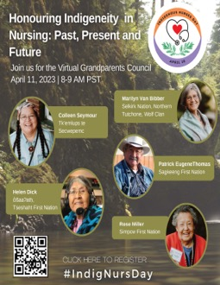
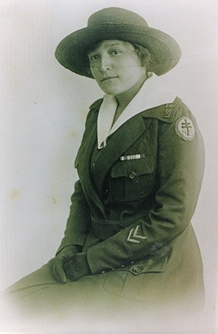
Intergenerational Mentorship Building on a legacy
Rose Casper
2nd Annual Indigenous Nurses Day
Edith Monture
Grandmother’s Council
Research Advisory
Schools of Nursing
Communities of Practice
Action Research Leads
Nurses
Notes:
GRANDMOTHERS & KNOWLEDGE HOLDER COUNCIL: Marilyn Van Bibber, June Shackley, Evelyn Voyageur, Madeline Dion-Stout, Rose Miller & Colleen Seymour
RESEARCH ADVISORY TEAM: Cora Webber-Pillwax (UofA), Brenda Cameron, Malcolm King (USask), Rod McCormick (TRU) & Shelly Johnson (TRU), Graham Smith (UOA), Janet Smylie (U of T), & Miriam Stewart (UBC)
NURSES/YOUTH/STUDENT MENTORSHIP: High school students, nursing students, and current Indigenous graduate students: Dawn Tisdale, Jessy Dame, Rose Melnyk, Nikki Hunter & Amy Mawdsley
SCHOOLS OF NURSING: Dr. Rani Srivasta (TRU), Dr. Susan Duncan (UVic), Dr. Sheryl Reimer-Kirkham (TWU), & Dr. Andrea Kennedy (MRU)
COMMUNITIES OF PRACTICE: BCNU, IH, FNHA Secwepemc Territory
ACTION RESEARCH LEADS: Dr. Lisa Bourque Bearskin (Chair), Liquaa Wazni (Research Associate), Christina Chakanyuka and Wenona Johnny (Undergrad Student)
Every year on April 10th, we mark Indigenous Nurses Day. April 10th is the birthday of Edith Monture, who is recognized as the first Indigenous Nurse in Canada. Rose Casper is recognized as the first Indigenous nurse in BC. Building on the legacy of these nurses is a privilege and a responsibility. Our hope is that Indigenous Nurses Day, through the affirmative action of our allies and partners, will be recognized federally and internationally.
We have brought together a large number of allies and organization that operate at both the

Slide 6
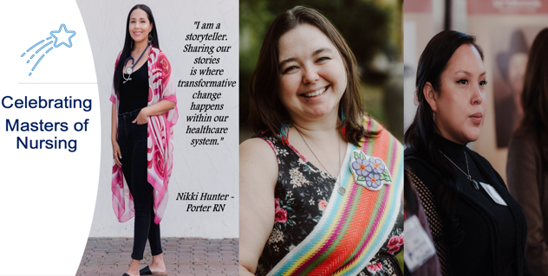
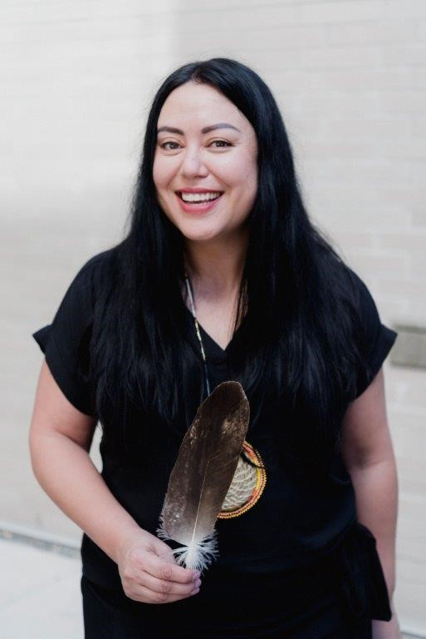
Experiential research work
Nikki Rose
Hunter-Porter
St’uxwtéws
Michelle
Padley
Métis Nation BC
Victoria Dick
c̓išaaʔatḥ (Tseshaht)
Rose
Melynk
St’uxwtéws
Mitacs
IMN-PN
MNBC
BCNU
Photo Credit
Billie-Jean Gabriel Photography
BC NEIHR
Sask NEIHR
Interior Health
FNHA
BCCNM
NNPBC
Notes:
2022-2023. BC NEIHR Master’s Scholarship. British Columbia Network Environment for Indigenous Health Research (BC NEIHR).
Scholarship and Research
Supporting Student led projects-
Presentations-locally, nationally and internationally
Publications

Slide 7
Optimizing scope of practice
Championing Indigenous led nursing research as a reclaimative practice
Co-designing IHN scholarship and professional practice.
Advancing health equity by focussing on rights, wellness, and strength of First Nations, Inuit and Métis Peoples.
Co-creating wise practices that address barriers to culturally safe care, education and professional practice
Activities in Progress.
Co leading the National Indigenous nurses day.
Scoping Review
Rapid Review
Distinction-based Indigenous Nursing Education
Co-leading the Collaborative I-GEN Project
Notes:
Promote participation and empowers nurses to enhance patients' access to traditional Indigenous wellness practices within culturally safe and secure health care working environments.
Advance Indigenous nursing research scholarship and development of Indigenous Health Nursing (IHN) as a professional practice.
Compliment the role and efforts of Indigenous community-based health services and programs.
Collective focus current wise practices, understand barriers to cultural safety and security in Indigenous health care, optimize a scope of practice and identify the regulatory standards, education, and policy changes required to move towards its implementation.
Activities in progress
Co leading the Nation Indigenous Nurses Campaign
Year 2 National Recognition Indigenous Nursing Day- April 10, 2023
Advocation for a national proclamation
Scoping Review
Collaboration with UVic CEiHNC (JIB Centre of Excellence)
Critical and Indigenous participatory designed
Rapid Review
Collaboration with UVic CEiHNC (JIB Centre of Excellence)
Wise practices & Structural factors
Distinction-based Indigenous Nursing Education
Focused Interviews with Indigenous Registered Nurses in BC
30+ Interviews completed
Co-leading the Collaborative I-GEN Project
Co-designing collaborative principle for institutional collaboration
Co-developing local hub partnership, roles and responsibilities

Slide 8
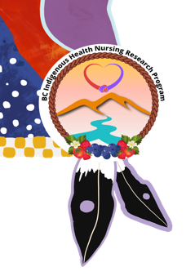
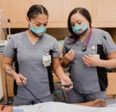
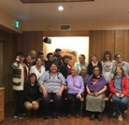
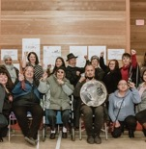
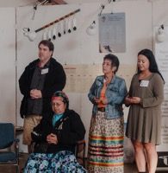
Reclaiming and Recovering Indigenous Knowledge in Graduate Nursing:
Intergenerational Learning with Communities
Funding:
Awarded CIHR Operating Grant of $684,676
FNHA in-kind $120,000 to assist graduate student transition to leadership
Ministry of Advanced Education 200K to support Collaborative Collective
Purpose: To support the co-creation and implementation of Indigenous wellness curricula and practice experiences, guided and led by local community protocols, priorities, and Indigenous research methodologies through Indigenous community partnerships in collaboration with Indigenous and non-Indigenous health and education providers.
Photo Credit
Billie-Jean Gabriel Photography

Slide 9
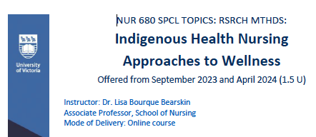
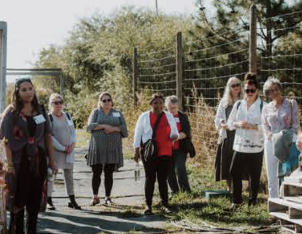
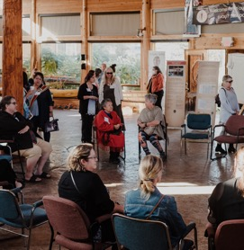
Indigenous Graduate Education in Nursing
(I-GEN)
Notes:
The purpose of this project is to support the co-creation and implementation of Indigenous wellness curricula and practice experiences, guided and led by local community protocols, priorities, and Indigenous research methodologies through Indigenous community partnerships in collaboration with Indigenous and non-Indigenous health and education providers.
The core values of respect, relationality, responsibility and relevance inform the collaborative spirit between institutions and communities in this model, which is centred around the four pillars of education, research, policy and practice, and that includes regulatory bodies and professional associations.
Awarded CIHR Operating Grant of $684,676 for 4 years
Organizational Support
Ministry of Advanced Education
FNHA

Slide 10
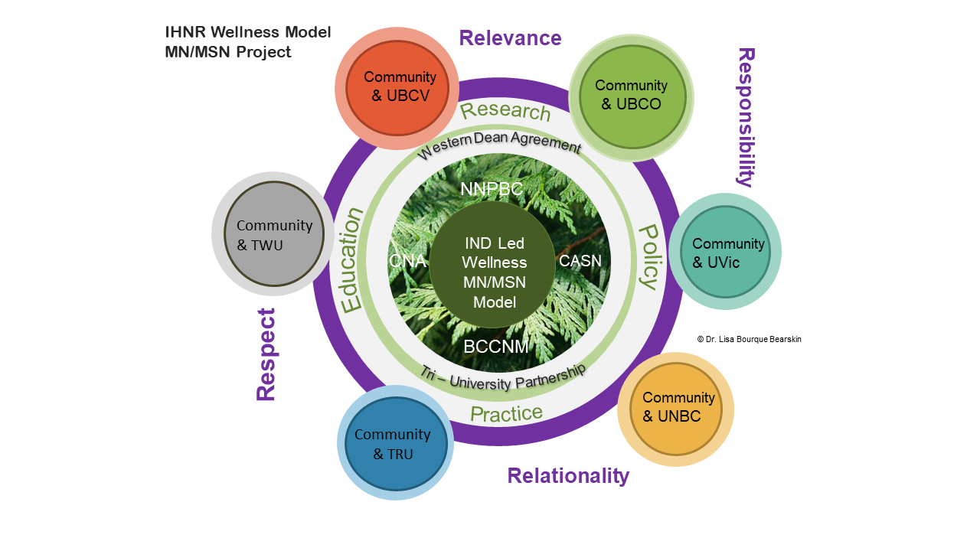
Co-Designing Collaborative Research Principles/Framework
#1 – Establishing Collaborative Collective
#2 – Co Creating Learning Curriculum
Co create core nursing courses*
Expanding elective courses
#3 - Making Culturally-Safe Spaces
Identify Indigenous Nurses and other Indigenous health experts (inc. traditional knowledge keepers) to be mentors for students.
Create Indigenous leadership opportunities
Considering community based projects
Partner with Health authorities
Notes:
Figure 1 illustrates the Collective Strategic Collaborative Indigenous Wellness Model, with core institutional hubs intersecting with organizational health leaders, institutional faculty working across systems of education, practice, research and policy, while centering Indigenous calls for systems change, as a targeted nursing research strategy.

Slide 11
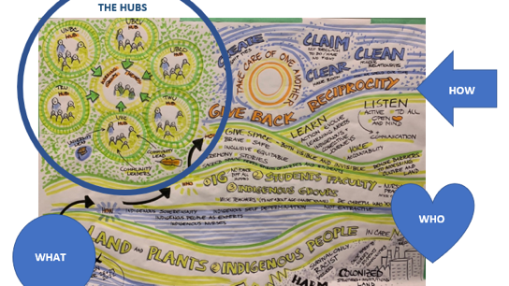
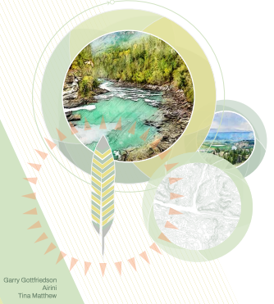
Intergenerational Mentorship
Co Create Elective Courses
Co-designing Local Hub Partners, Protocols and Process
Review & Support Core Courses
Celebration, Ceremony & Commitments
Local
Community TRU
Community-University Partnership
Indigenous Community (Leaders & Nurses)
Local
UBCO
IND-Led Wellness MN/MSN
Local TWU
Local UBCO
Local
UVic
Local
UNBC
Local Nation Research Guidelines
We respect the lived experiences of local Indigenous Peoples
We respect and protect the diversity of local knowledges.
We respect and honor collaborative and local partnership.

Slide 12
Critical Questions
We each have an active role interrupting Indigenous-specific racism and oppression. As nurse researchers working at addressing equities and finding ways to elevate historically and systemically marginalized groups. We ask the question what is the most effective way to confront systemic racism?
How do we address the privilege given to Western forms of knowledge in Nursing Education in order to be inclusive of Indigenous ways of knowing, learning, being and doing?
Notes:
You can verbally give thanks to your moderator and others here. If you want to add more to the summary – easy to edit!

