Slide 1
Reclaiming and Recovering Indigenous Knowledge in Graduate Nursing Education: Intergenerational Learning with Communities
February 8, 2024

Slide 2
We acknowledge the collective wisdom of the lək̓ʷəŋən & WSÁNEĆ Territories & Sencoten-speaking peoples where UVIC is situated. As an uninvited guests, we have been respectfully reaching out and committed to developing and strengthening relationships with the Songhees, Esquimalt, and WSÁNEĆ peoples to uphold their collective rights and responsibilities to protect their lands, peoples, and culture, whose historical and dynamic relationships with the land continue to this day. Especially in gratitude to the Elders, and Knowledge holders past, present, and future for they hold the memories, traditions, and hopes and dreams of their families and nations.
Notes:
First let me begin by acknowledging our traditional territories where some of us may be situated.
Begin in gratitude, gratitude for to have another day, breathing in the fresh air, soaking up the energy we receive from each new day. Gratitude for the land from we are each located. To honor the ancestors that come with each of you, the four legged, the winged being, and the water people, grandmother moon, and grandfather sun, keeping an open mind to so we can advance our collective consciousness, as we listen to the land we hear the birds, we see the trees, and smell the water and we feel connected to our own spiritual ways of knowing that keep us grounded and centered, holistically rooted in wellness.

Slide 3
AGENDA
Opening Check-in
Overview on progress
Feedback survey results
Website development
IGEN Program
Governance model- Collaborative Principles
Working group updates
Home fires/circles updates
Special Topics
4) Research Activities
Document analysis
Rapid Review
6) Budget overview
7) Additional Items

Slide 4
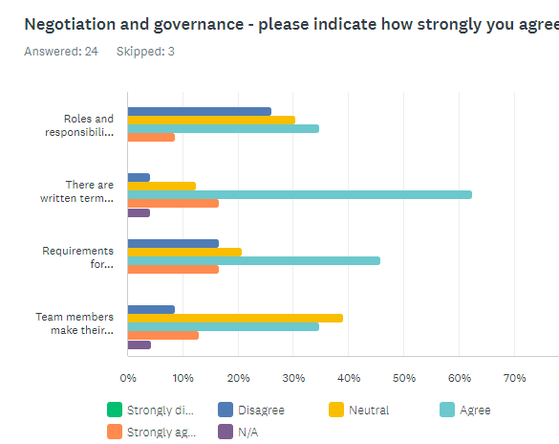
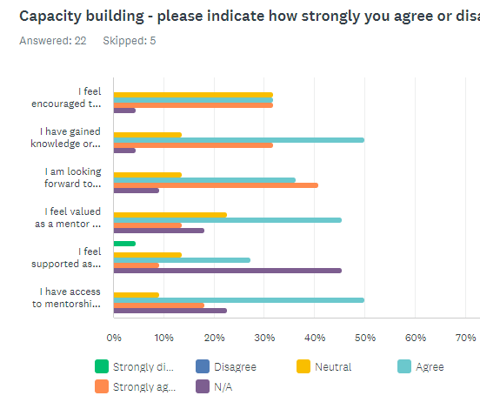
Survey Results: What we heard

Slide 5
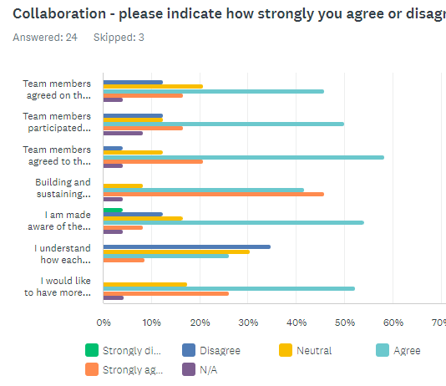
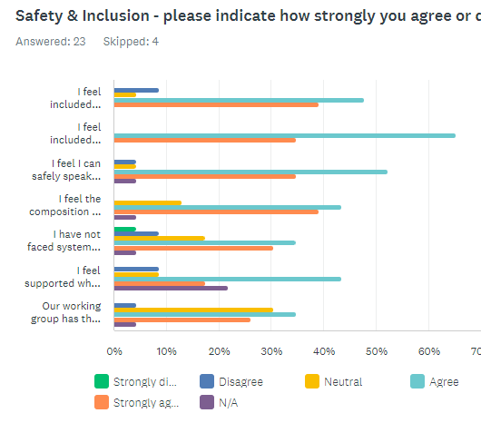
Survey Results: What we heard

Slide 6
Survey Results: What we heard
“Begin each meeting in a good way; respect of Elders and each other and partners. Take a holistic perspective in supporting research process, Indigenous nurses, and development of Indigenous nursing curriculum with the vision of improving Indigenous health.”
Strengths:
Mentorship is available and mentors feel valued
>50% offered opportunity to engage in decision making and project direction
47% asked to contribute feedback, 30% offered co-leadership
Capacity building - research knowledge, community engagement, etc
Areas for improvement in clarity and communication:
Clarification of roles and responsibilities of team members, and working groups
Expectations and criteria for deliverables
Availability and transparency of project documents
Clarity of work being done in other groups

Slide 7
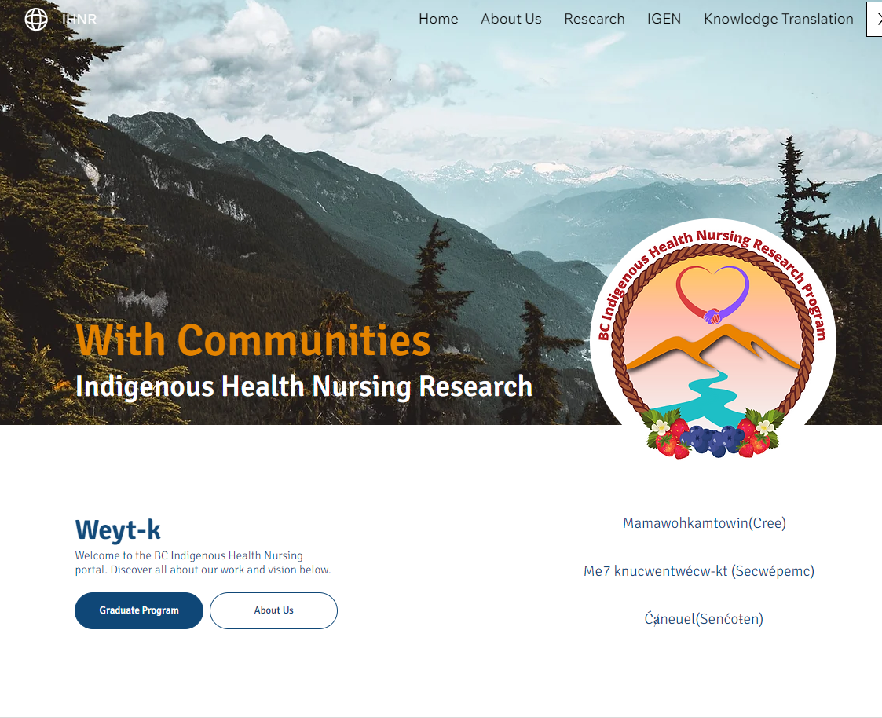
Branding: Logo and Website

Slide 8
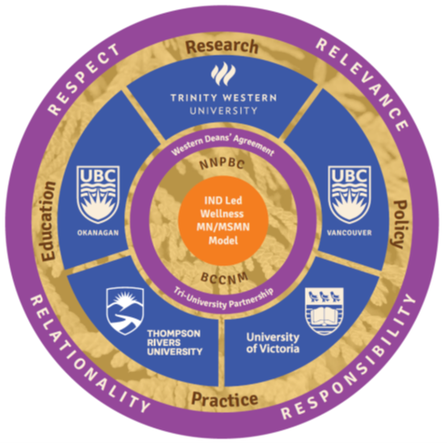
Collaborative Program Revised Framework
Goals:
1) work with local Indigenous community leaders, Elders, and Knowledge Keepers and SON to study the co-development, co-implementation and co-evaluation of a collaborative multi-site university-community, culturally safe, gender-relevant Indigenous wellness curricula inclusive of Traditional and Western Knowledge pathways.
2) contribute to knowledge about community driven Indigenous wellness place-based equity education, training, and mentorship of graduate students, nurses and other health professionals, with Indigenous communities.

Slide 9
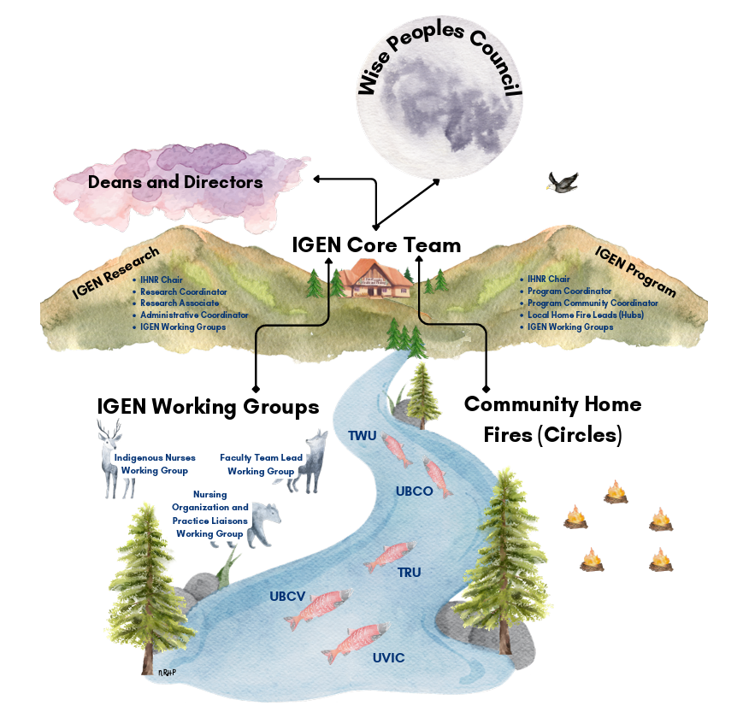
Generative
Vision 2.0
Notes:
Nikki to discuss culmination of work todate.

Slide 10
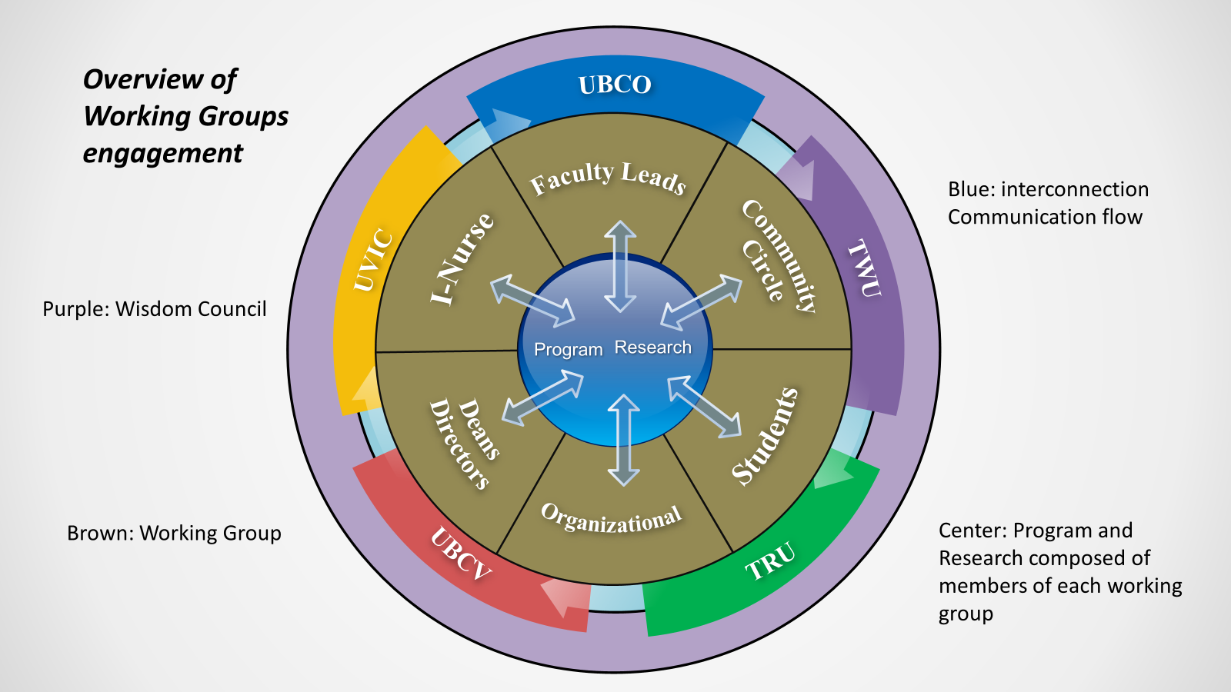
Notes:
Call on site leads and working group chairs to speak to their work ** the ask is for working groups to complete their TOR documents

Slide 11
Collaborative Indigenous Wellness Graduate Stream
(Draft Example Model)
First Year (example)
September-December | January-April | May-August
Intergenerational Learning 1 (1.5 U ) (Community-Led Circle) | Intergenerational Learning 1 (.75 U ) (Community-Led Circle) | Intergenerational Learning 1 (.75 U ) (Community Led Circle)
MN Foundation of Home Institution (Community Led Circle) Western Dean’s Agreement | MN Foundation of Home Institution (Community Led Circle) (WDA) | MN Foundation of Home Institution (Community Led Circle) (WDA)
 | MN Foundation of Home Institution | MN Foundation of Home Institution
Second Year
Intergenerational Learning III (1.5 U across two terms] (WDA) | Intergenerational Learning III (1.5 U across two terms) (WDA) | MN Foundation NUR 596 Capstone (1.5 U) (1.5 U across two terms)
Recommended Electives Potential courses (1.5 U x 2) Potential Courses already developed (WDA) (Community Led Circle) | NUR 596 Capstone (1.5 U) (1.5 U across two terms) (Community Led Circle) (WDA)
Course-Based MN: Indigenous Wellness Stream
Total 16.5 U
6 MN Foundation Courses = 9 units
3 Indigenous Wellness Stream Required Courses = 4.5 units
2 Elective Courses = 3.0 units
Foundational Courses with access to local community health leaders, and knowledge holders at local HOME institution
Indigenous-Led Wellness Courses offered through Western Deans’ Agreement [WDA] across collaborating institutions
Possible Electives connected to various sites.
Notes:
Master of Nursing (Indigenous Health) Course-Based MN (Special Arrangement/Pilot)

Slide 12
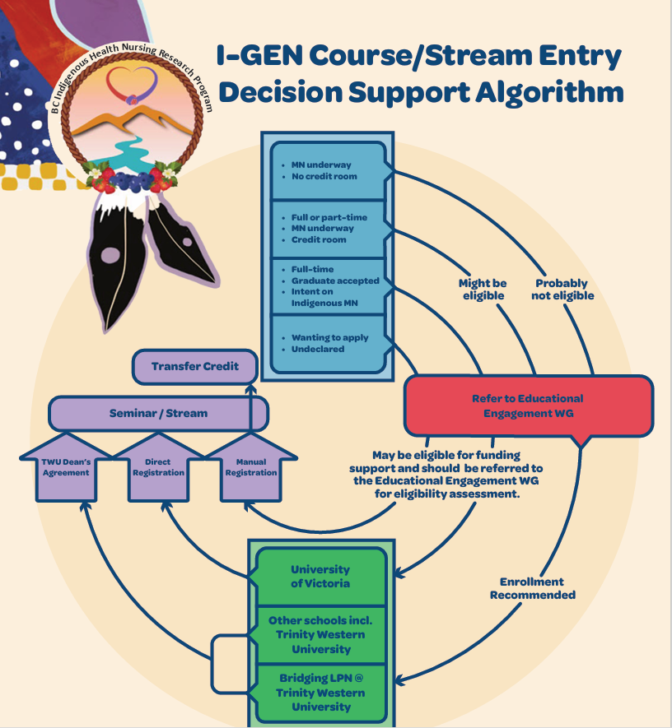
Admission pathway Nurs: 680 Course
Vetted and developed by the Indigenous Nurses Working Group in collaboration with the Program/Research leads.
Notes:
This template will be important moving forward when screening applicants interested in MN Stream.

Slide 13
Nurs 680 Special Topic: Indigenous approaches to Wellness
Update: 17 students. 8 preparing MN Applications, 4 already in MN program and 5 students on the fence. ADD Pic from Cohort Ceremony

Slide 14
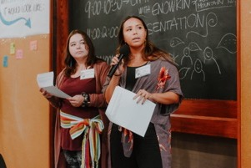
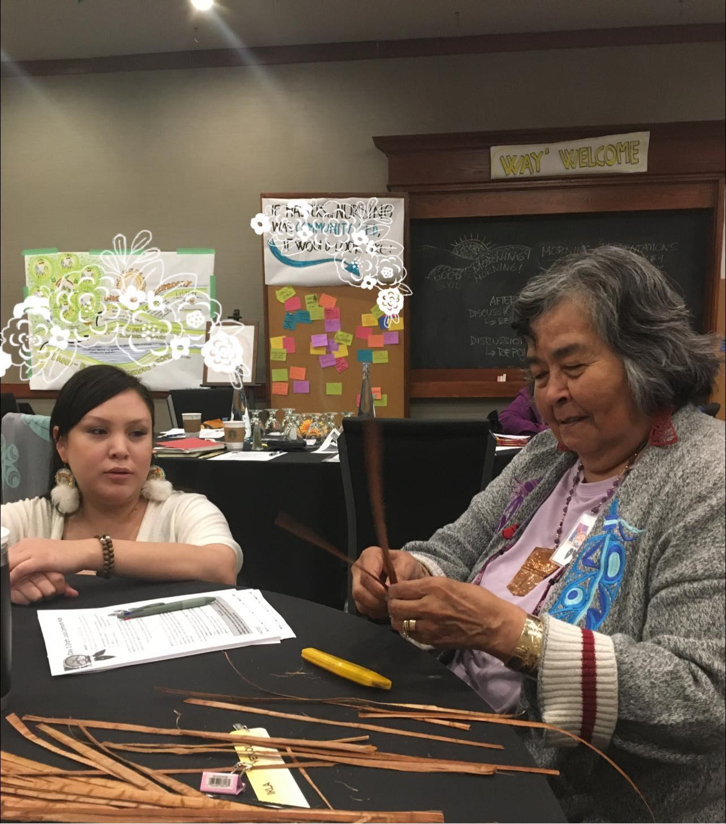
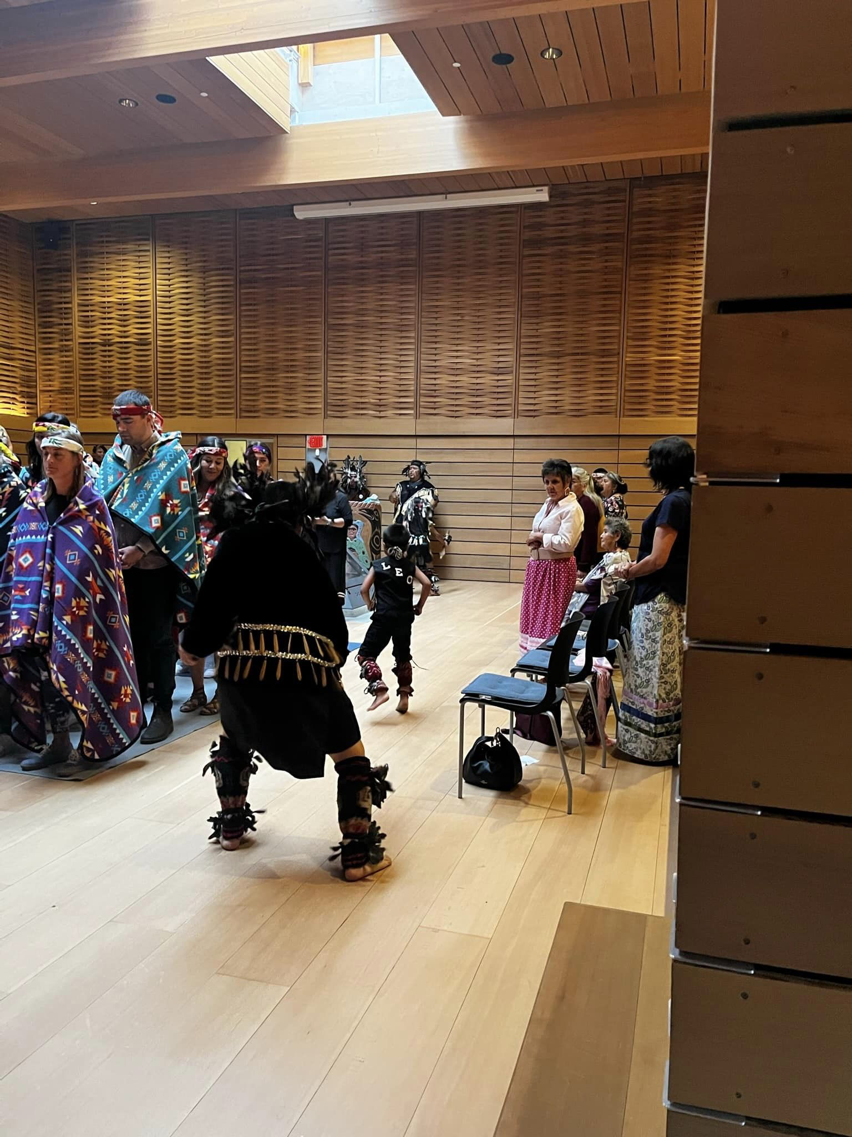
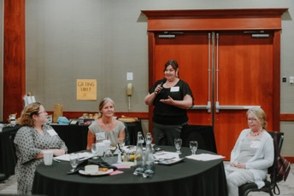
GENERATIVE
RESEARCH ACTIVITIES
CO-DESIGNING PROTOCOLS,
PRINCIPLES & PROCESSES
Phase 1: Document analysis up to now examining context (ethics submitted)
Phase 2: Attitudes & readiness of schools
Phase 3: Evaluation of students’ experiences
Phase 4: Evaluation of Community Leadership
Phase 5: Collective Evaluation and generation of draft Indigenous Health Wellness Masters stream

Slide 15
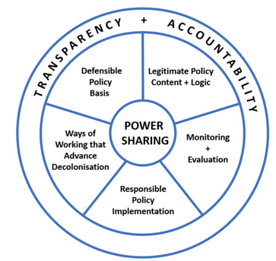
Document Analysis
Question: What are facilitators and barriers to collaboratively developing and implementing Indigenous Graduate Education in Nursing across five institutions in BC? Progress: Collaborate on sub-questions Fine-tune analytic framework Await documents from sites & working groups Recruit analysis team members! | Documents: 1. Process - meeting minutes, emails 2. Context - SON strategic plans, curriculum, learning outcomes, TRC, CINA & CASN frameworks

Slide 16
Budget Overview
 | Year 1 2022-23 | Year 2 2023-2024 to date | Year 3 2024-2025 | Year 4 2025-2026
Received | $171,180 | $171,180 | $171,180 | $171,180
Research Spent | $60,868 | $50,122 and ( $181,798 transfers for years 1-3)
Remaining - cumulative | $110,312 | $110,440 | $281,620 | $452,800
Program $2,635,000 |  | $445,000 $25,000/site $850/mth stipend | $1,095,000 | $1,095,000

Slide 17
Timeline
2022
2023
2024
2025
Phase 3. Research Capacity Building & Strengthening
Phase 4. Generative Knowledge and Reciprocity
Phase 5. Knowledge Interchange & Evaluation
Phase 1. Community Engagement & Partnership Development
Co-develop strategic engagement process
Phase 2. Two-way learning and evaluation processes
Support students in achieving their career goals
Establish Community Education and Research Liaisons (CERL), formation of site advisory teams
Collaboratively develop, implement, and evaluate a culturally safe Indigenous Wellness curricula
Appraise experiences of the collective in co-creating the program and processes to support nurses in their communities and students in their schools
Notes:
Review asks: working group TOR documents, help with document analysis, could be grad students, collaborative curriculum blueprint for Intergenerational Learning courses,

Slide 18
Collaborative Course Blueprint: Proposed New IND-W Seminars
Intergenerational Learning 1 - focuses on building relationships with community, students and faculty across the province and situating Indigenous Nursing Research Leadership.
Intergenerational Learning 2 - focuses on further developing critical inquiry skills and embedding Indigenous knowledge into nursing leadership practice. Includes a land-based immersion experience, fostering deeper understanding of the interconnectedness of Indigenous Knowledges and Indigenous research methodologies.
Intergenerational Learning 3 - focuses on supporting independent scholarship and transitioning into advanced practice roles, as a pivotal learning opportunity for students during the thesis and project phases of their MN studies.
Key Principles: Intergenerational Mentorship. Community Led, Distinction base focused. of community-led research knowledge in the advancement of Indigenous nursing leadership theory and practice is addressed. Community leaders, students and faculty collaborate on topic selections, session organization, and securing guest speakers to help facilitate a comprehensive learning experience.
Notes:
situating the student in the context of…

Slide 19
WHAT ARE WE MISSING? WHAT CAN WE DO BETTER? WHERE CAN YOU ASSIST?

